Slide 1
Build 1
Design & Development
Testing
Implementation
Build 2
Requirements
Design & Development
Testing
Implementation
Build N
Design & Development
Testing
Implementation

Slide 2
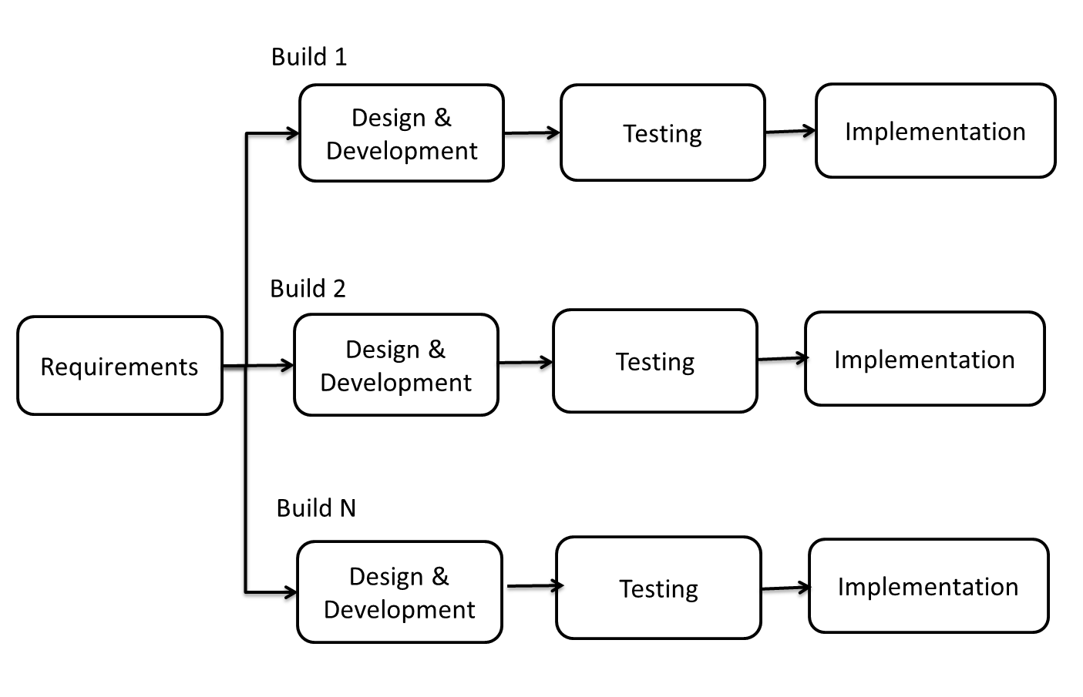

Slide 3
Index exchange
Mid, did, λid
Nid, eid, gid
Encryption
Decryption
User
Plain text
Cipher text
Keys
Prime
numbers
Invalid Prime
numbers
Key Generation
N, e, g
Mid, did, λid
Plain text
Nid, eid, gid
M, d, λ
Keys
Database
GUI

